Slide 1
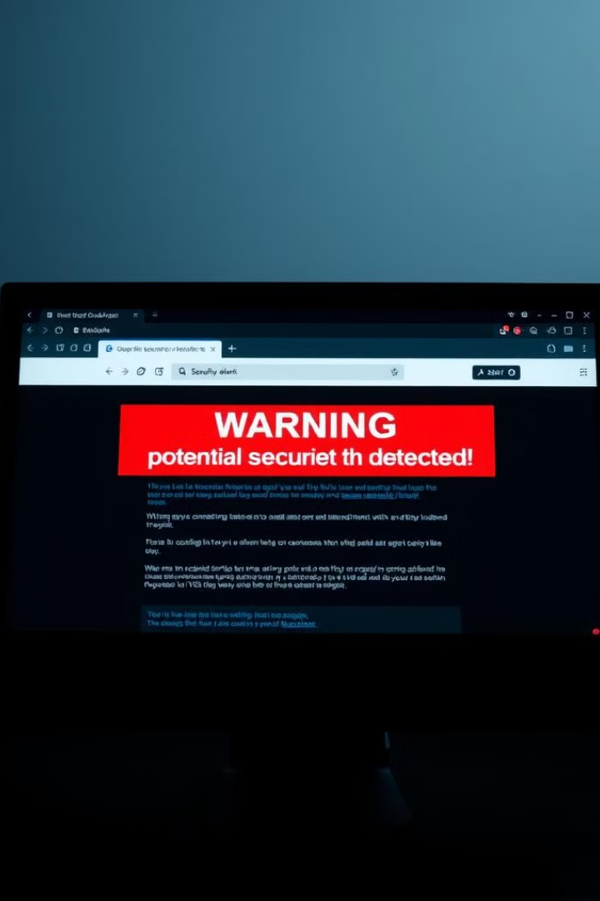
Phishing Detection System Using Machine Learning

Slide 2
Group Members :
ROLL NO. | PRN | NAME
372068 | 22320002 | JIYA R. BAGWAN
372070 | 22320072 | TUSHAR KOMPA
3720721 | 22320113 | DIYA JAIN
372072 | 22320127 | AJAY INGLE

Slide 3

Introduction to Phishing Attacks
Phishing attacks are a growing threat that can lead to devastating consequences. This project aims to develop a web-based system that leverages machine learning to reliably detect and prevent phishing attempts, protecting users from financial losses and identity theft.

Slide 4
Project Overview
Goal -
Create a web-based system that can identify phishing attempts by analyzing URLs .
Objective-
Provide users with real-time phishing detection using a pre-trained machine learning model.
Focus-
Develop a user-friendly interface that delivers accurate phishing detection and classification.

Slide 5

Challenges in Traditional Phishing Detection Methods
Evolving Tactics
Lack of Scalability
Phishers constantly adapt their techniques to bypass traditional detection methods.
Manual review processes are unable to keep pace with the volume of phishing attempts.
Increasing Complexity
User Vulnerability
Sophisticated phishing scams can mimic legitimate websites and communications.
Even vigilant users can be tricked by convincing phishing attempts.

Slide 6

Machine Learning Approaches to Phishing Detection
1
Feature Extraction
Identifying key characteristics of phishing and legitimate URLs or emails.
2
Model Training
Using supervised learning techniques to build a classification model.
3
Real-Time Prediction
Applying the trained model to classify new inputs as phishing or legitimate.

Slide 7

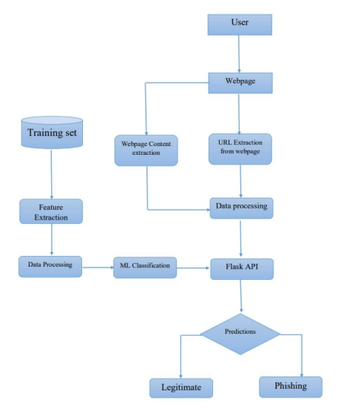
Workflow:

Slide 8
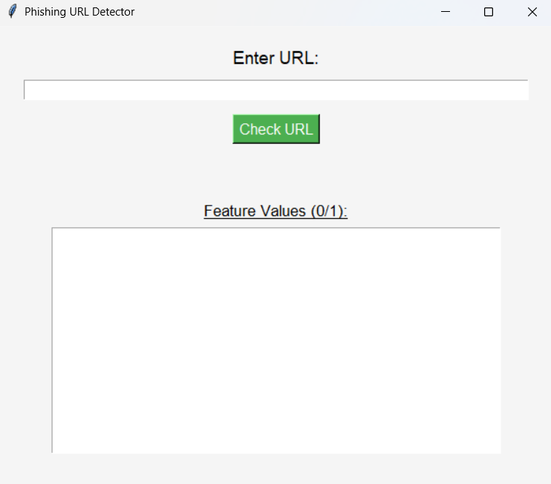
Output:

Slide 9

Conclusion
By leveraging machine learning, this phishing detection system offers a robust and scalable solution to protect users from the growing threat of phishing attacks. The combination of advanced feature extraction and reliable classification models ensures accurate real-time detection, empowering users to stay safe online.

